Slide 1
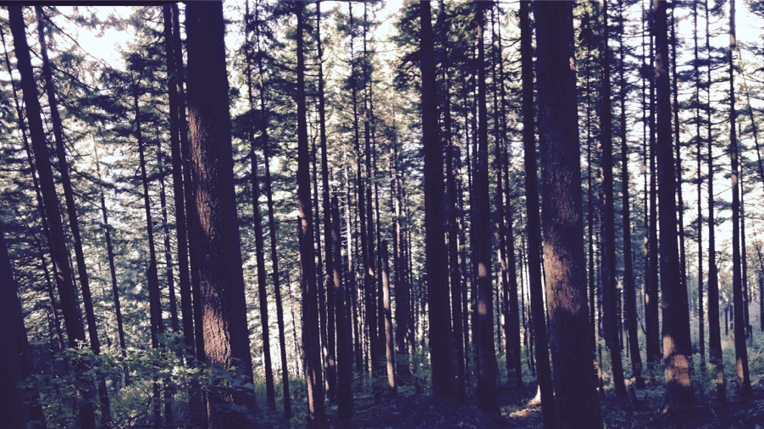
Plants aren’t dumb Using optimality theory to understand big questions in plant ecophysiology
Nick Smith
Department of Biological Sciences
Texas Tech University

Slide 2

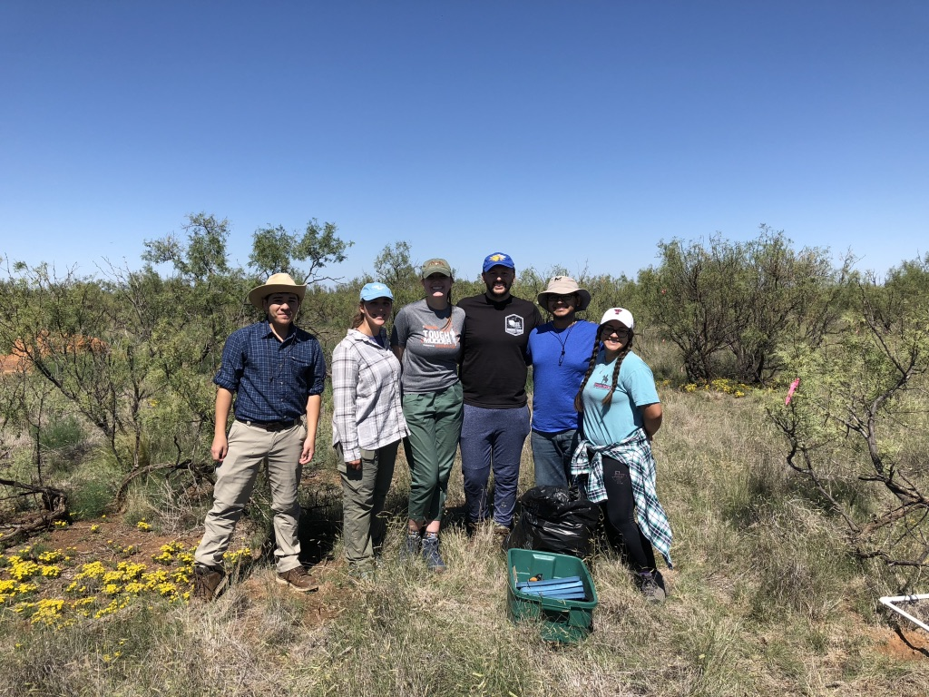
Acknowledgements
Smith Ecophysiology Lab
Lizz Waring (now AP at Northeastern State U)
Helen Scott (now in industry)
Evan Perkowski
Risa McNellis
Next Generation Ecosystem Modeling Group
Colin Prentice (Imperial College)
Trevor Keenan (UC Berkeley)
Wang Han (Tsinghua U)
Beni Stocker (ETH Zurich)

Slide 3
Photosynthesis is important!
nick.smith@ttu.edu; @nick_greg_smith

Slide 4
Photosynthesis is important!
nick.smith@ttu.edu; @nick_greg_smith
Data from IPCC (2013)

Slide 5
Photosynthesis is important!
nick.smith@ttu.edu; @nick_greg_smith
Photosynthesis
Data from IPCC (2013)

Slide 6
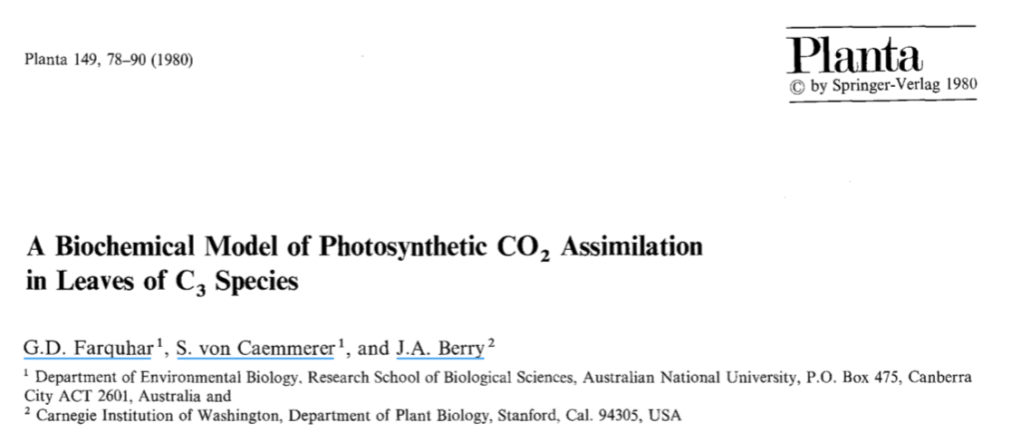
Theoretical models for photosynthesis exist
nick.smith@ttu.edu; @nick_greg_smith

Slide 7
These produce short term responses that match data
nick.smith@ttu.edu; @nick_greg_smith

Slide 8
Long-term responses can differ from short-term responses due to acclimation
nick.smith@ttu.edu; @nick_greg_smith

Slide 9
Long-term responses can differ from short-term responses due to acclimation
nick.smith@ttu.edu; @nick_greg_smith
Dumb plants

Slide 10
Long-term responses can differ from short-term responses due to acclimation
nick.smith@ttu.edu; @nick_greg_smith
Acclimated to high light
Acclimated to low light

Slide 11
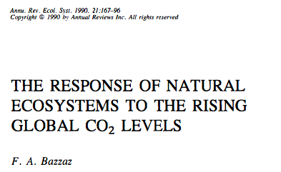
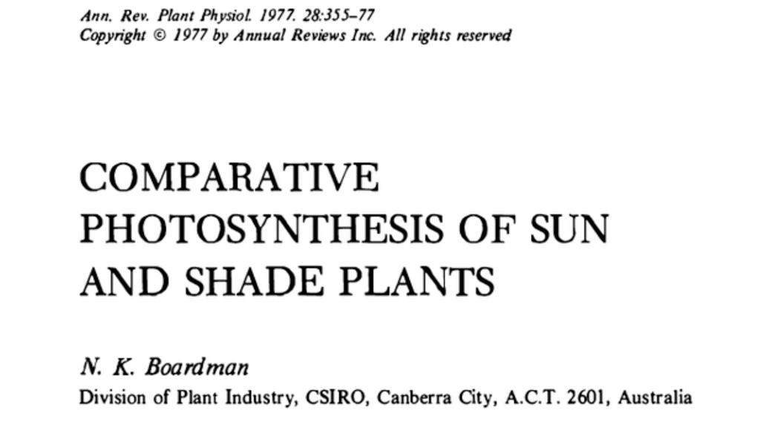
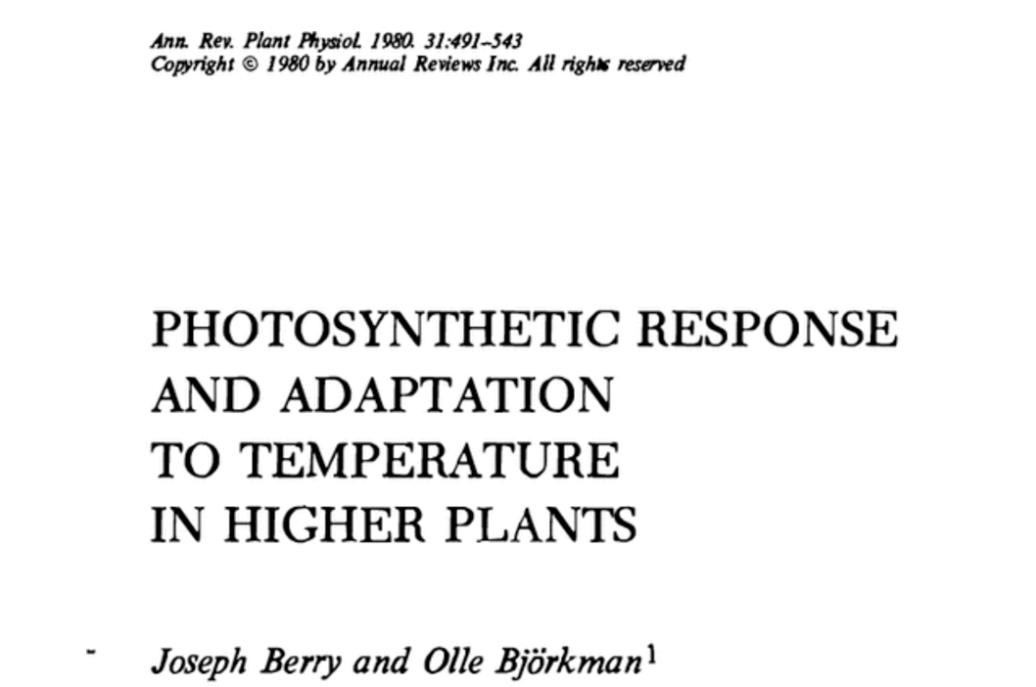
Acclimation is ubiquitous and well known…
nick.smith@ttu.edu; @nick_greg_smith
Temperature: Berry & Björkman (1980)
CO₂: Bazzaz (1990)
Light: Boardman (1977)

Slide 12
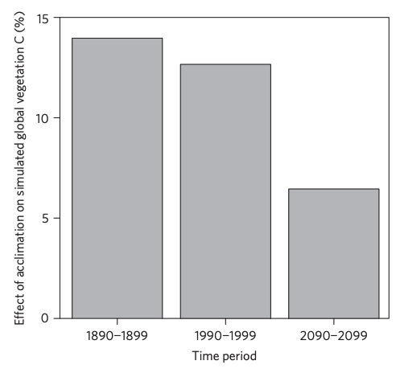
…and can impact carbon cycling and climate
nick.smith@ttu.edu; @nick_greg_smith
Acclimation increase future C storage by ~6%
Acclimation alters future temperature by >1°C
Smith et al. (2017) Nature Climate Change
Smith et al. (2017) JAMES

Slide 13
Here’s the rub: No theoretical model for photosynthetic acclimation exists
nick.smith@ttu.edu; @nick_greg_smith

Slide 14
Lack of theory results in…
nick.smith@ttu.edu; @nick_greg_smith

Slide 15
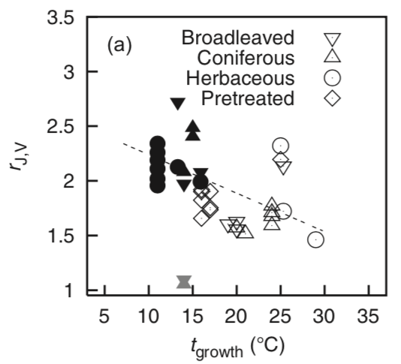
Lack of theory results in…
nick.smith@ttu.edu; @nick_greg_smith
Unreliable future predictions (overparameterization, tuning)
Resulting change in simulated photosynthesis
Physiological parameter
Environmental condition
Kattge and Knorr (2007) PC&E
Smith et al. (2017) JAMES

Slide 16
Lack of theory results in…
nick.smith@ttu.edu; @nick_greg_smith
Inability to test mechanisms
Resulting change in simulated photosynthesis
Physiological parameter
Environmental condition
Kattge and Knorr (2007) PC&E
Smith et al. (2017) JAMES

Slide 17
Our Goal: Develop a mechanistic model of photosynthetic acclimation based on optimization and the first principles of plant physiological theory
nick.smith@ttu.edu; @nick_greg_smith

Slide 18
Optimization: Least cost hypothesis
nick.smith@ttu.edu; @nick_greg_smith
Maintain fastest rate of photosynthesis at the lowest cost (water and nutrient use)
Wright et al. (2003) American Naturalist

Slide 19
Optimal photosynthesis
nick.smith@ttu.edu; @nick_greg_smith
Photosynthesis = f{stomatal conductance,
photosynthetic biochemistry}

Slide 20
Optimal photosynthesis
nick.smith@ttu.edu; @nick_greg_smith
Photosynthesis = f{stomatal conductance,
photosynthetic biochemistry}
Must predict optimal rates of both

Slide 21
Optimal photosynthesis
nick.smith@ttu.edu; @nick_greg_smith
Photosynthesis = f{stomatal conductance,
photosynthetic biochemistry}

Slide 22
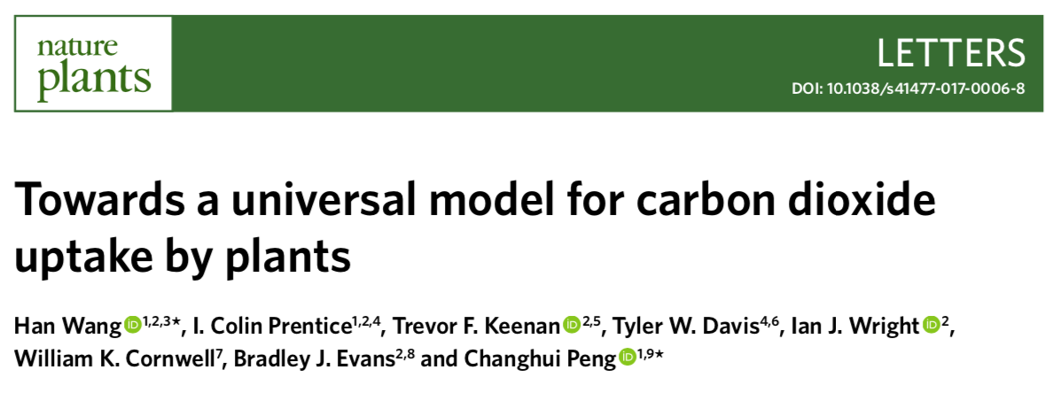
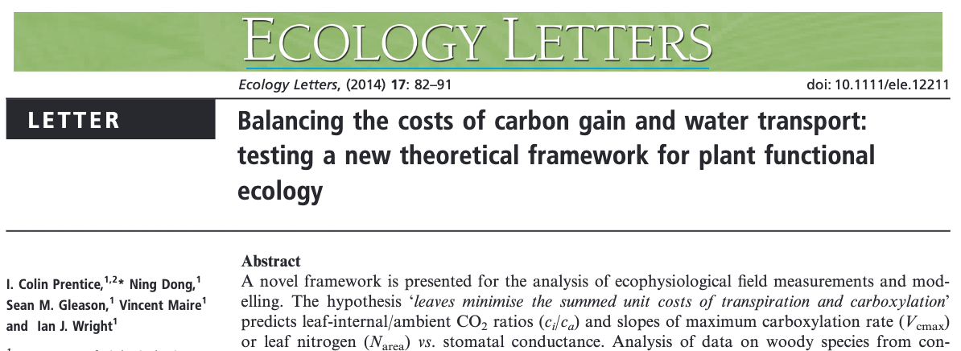

Slide 23
nick.smith@ttu.edu; @nick_greg_smith
Open stomata:
Benefits
High CO₂ influx
Costs
High water outflux
Closed stomata:
Benefits
Low water outflux
Costs
Low CO₂ influx

Slide 24
nick.smith@ttu.edu; @nick_greg_smith
Open stomata:
Benefits
High CO₂ influx
Costs
High water outflux
Closed stomata:
Benefits
Low water outflux
Costs
Low CO₂ influx
Must maintain high amount of Rubisco to do photosynthesis

Slide 25
Optimal stomatal conductance
nick.smith@ttu.edu; @nick_greg_smith
Optimal conductance maximizes photosynthesis at least water loss and nutrient use
Water loss is from transpiration
Nutrient use is nutrients used to maintain Rubisco
Rubisco proxy is V_{cmax}

Slide 26
Optimal χ is a function of the costs and the environment
nick.smith@ttu.edu; @nick_greg_smith
χ = f{temperature,
CO₂,
vapor pressure deficit}
Prentice et al. (2014) Ecology Letters; Wang et al. (2017) Nature Plants

Slide 27
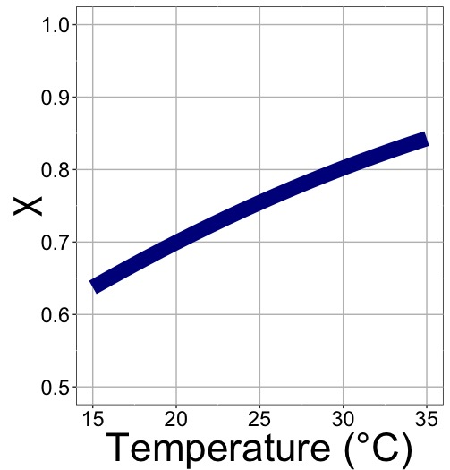
nick.smith@ttu.edu; @nick_greg_smith
χ increases with temperature because of greater photorespiration

Slide 28
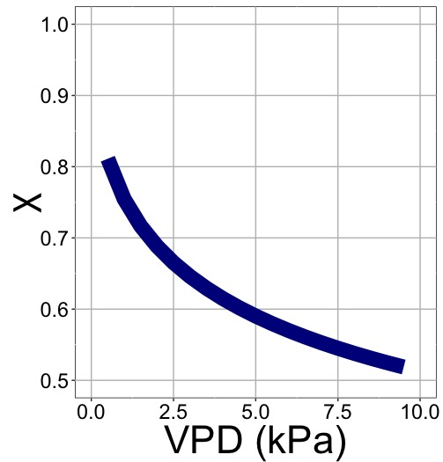
nick.smith@ttu.edu; @nick_greg_smith
χ decreases with VPD because of greater water loss

Slide 29
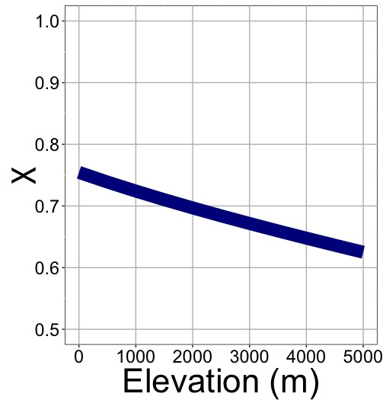
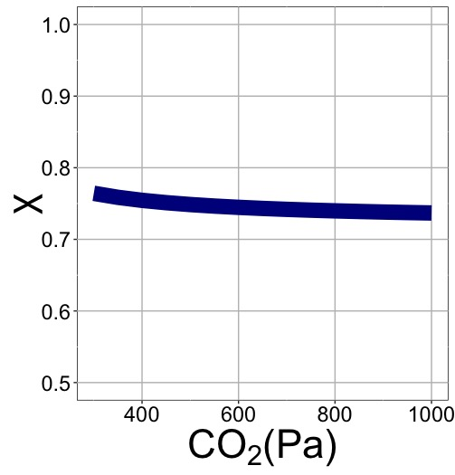
nick.smith@ttu.edu; @nick_greg_smith
χ decreases with elevation because of lower openness needed to satisfy Rubisco

Slide 30
nick.smith@ttu.edu; @nick_greg_smith
χ decreases with elevation because of greater VPD

Slide 31
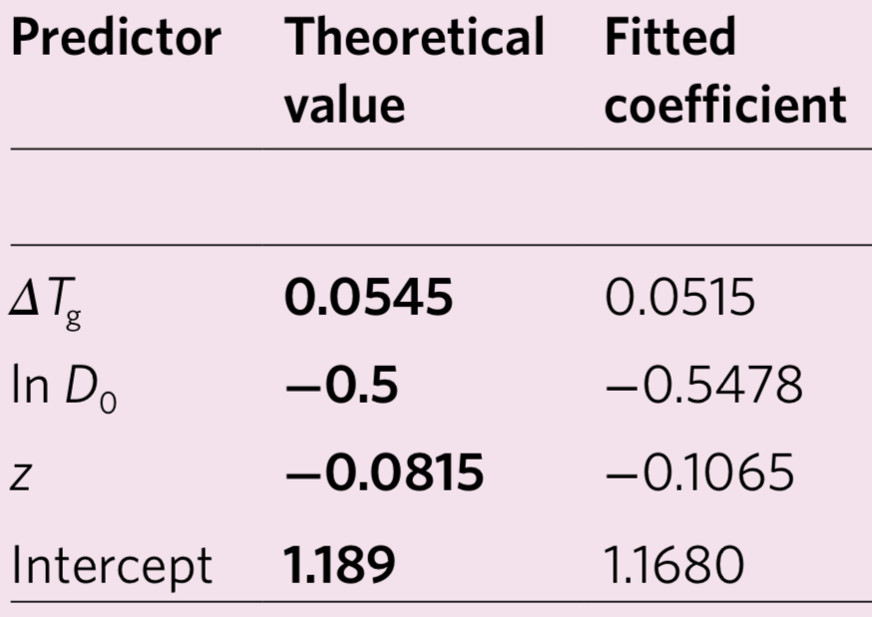
Globally, χ is optimized
nick.smith@ttu.edu; @nick_greg_smith
Wang et al. (2017) Nature Plants

Slide 32
Optimal photosynthesis
Photosynthesis = f{stomatal conductance,
photosynthetic biochemistry}

Slide 33
Biochemistry optimization: Coordination hypothesis
Photosynthesis may be limited by Rubisco carboxylation rate or electron transport rate to regenerate Rubisco

Slide 34
Biochemistry optimization: Coordination hypothesis
Photosynthesis may be limited by Rubisco carboxylation rate or electron transport rate to regenerate Rubisco
Optimally, plants will coordinate their biochemistry to be equally limited by both rates

Slide 35
Coordination of photosynthesis
nick.smith@ttu.edu; @nick_greg_smith
Optimally…
A_{c} = A_{j}
Electron transport-limited photosynthesis
Carboxylation-limited photosynthesis

Slide 36
Coordination of photosynthesis
nick.smith@ttu.edu; @nick_greg_smith
A_{c} = f {V_{cmax}, T, CO₂}
A_{j} = f {light, T, CO₂}
Carboxylation-limited photosynthesis
Electron transport-limited photosynthesis
Farquhar, von Caemmer, & Berry (1980) Planta

Slide 37
Rearrange to solve for measurable traits
nick.smith@ttu.edu; @nick_greg_smith
V_{cmax} = f {light, T, CO₂}
Smith et al. (2019) Ecology Letters

Slide 38
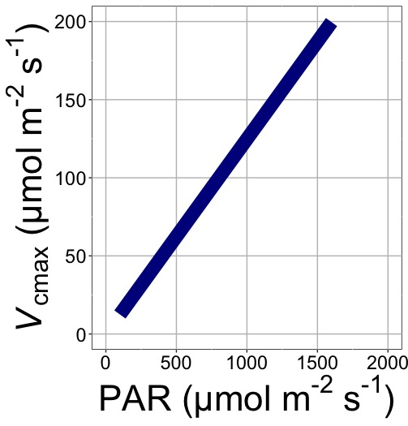
nick.smith@ttu.edu; @nick_greg_smith
V_{cmax} increases with light because of greater electron transport
Smith et al. (2019) Ecology Letters

Slide 39
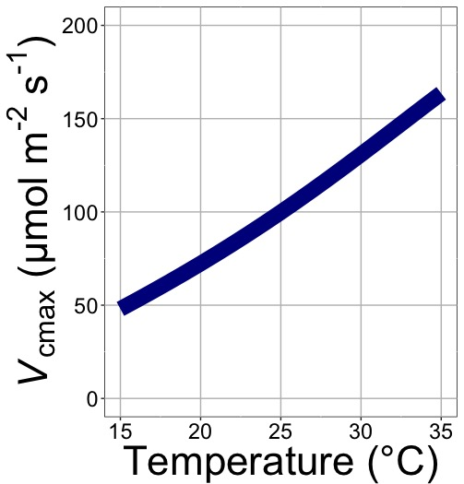
nick.smith@ttu.edu; @nick_greg_smith
V_{cmax} increases with temperature because of greater electron transport and photorespiration
Smith et al. (2019) Ecology Letters

Slide 40
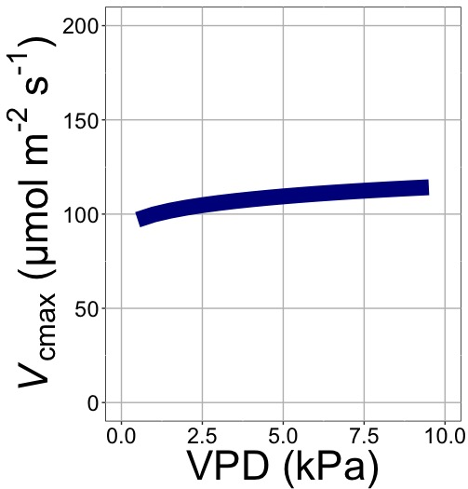
nick.smith@ttu.edu; @nick_greg_smith
V_{cmax} increases with VPD because of lower stomatal conductance
Smith et al. (2019) Ecology Letters

Slide 41
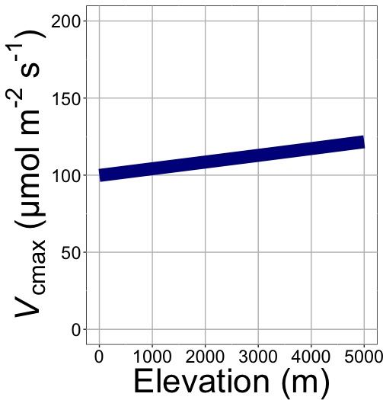
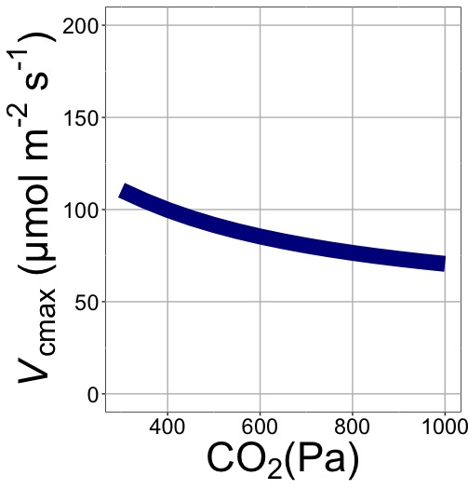
nick.smith@ttu.edu; @nick_greg_smith
V_{cmax} decreases with CO₂ because of lower c_{i}
Smith et al. (2019) Ecology Letters

Slide 42
nick.smith@ttu.edu; @nick_greg_smith
V_{cmax} increases with elevation because of lower stomatal conductance
Smith et al. (2019) Ecology Letters

Slide 43
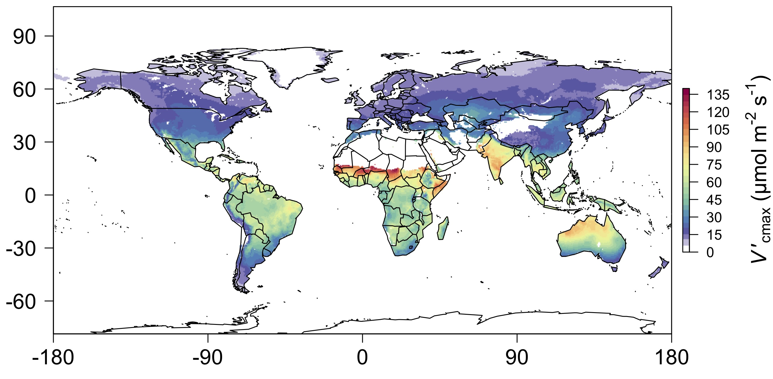
nick.smith@ttu.edu; @nick_greg_smith
We can predict optimally acclimated traits!
Smith et al. (2019) Ecology Letters

Slide 44
Ok, great, but now what?
nick.smith@ttu.edu; @nick_greg_smith

Slide 45
Let’s tackle some big questions in plant ecophysiology!
nick.smith@ttu.edu; @nick_greg_smith

Slide 46
Question 1: Is photosynthesis optimized to the environment?
nick.smith@ttu.edu; @nick_greg_smith

Slide 47
Global leaf isotope dataset
~4,000 observations
594 sites
Cornwell et al. (2018)

Slide 48
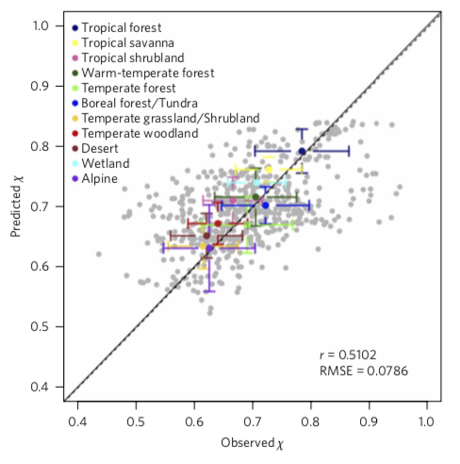
Stomatal conductance is also optimized!
Wang et al. (2017)

Slide 49
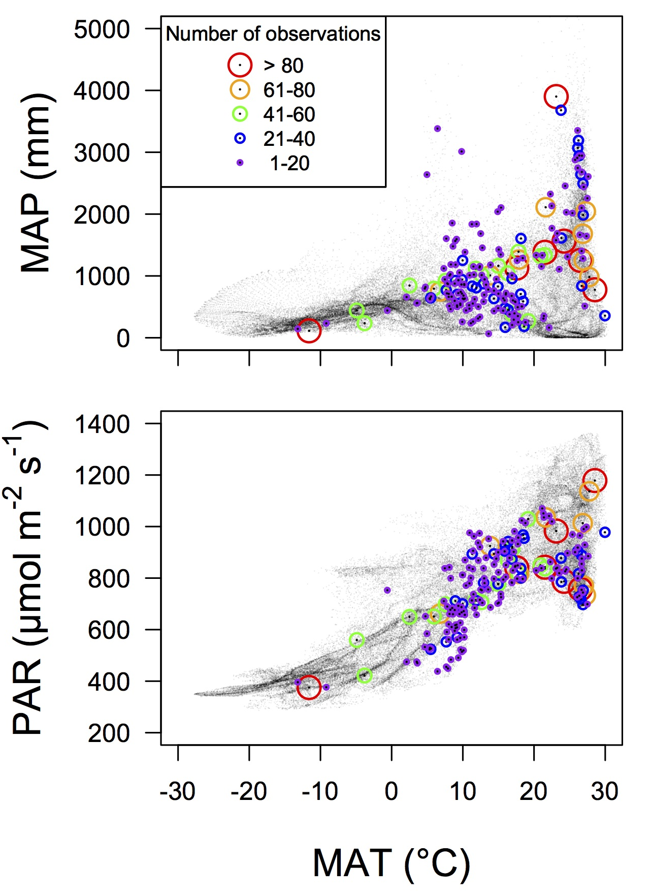
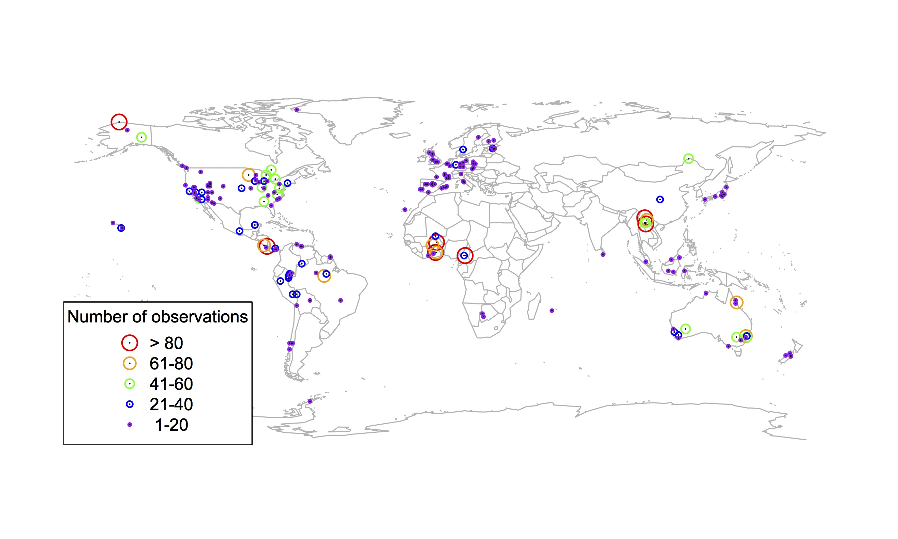
Global V_{cmax} dataset
nick.smith@ttu.edu; @nick_greg_smith
3,697 measurements
202 sites
> 600 genera
Smith et al. (2019) Ecology Letters

Slide 50

nick.smith@ttu.edu; @nick_greg_smith
Smith et al. (2019) Ecology Letters

Slide 51
Question 1: Is photosynthesis optimized to the environment? YES! Photosynthesis acclimates spatially as expected from optimization
nick.smith@ttu.edu; @nick_greg_smith

Slide 52
Question 2: How will photosynthesis acclimate to future conditions?
nick.smith@ttu.edu; @nick_greg_smith

Slide 53
Photosynthetic traits change with temperature and CO₂ in ways expected from optimization
nick.smith@ttu.edu; @nick_greg_smith
Smith and Keenan (in review)

Slide 54
Photosynthetic traits change with temperature and CO₂ in ways expected from optimization
nick.smith@ttu.edu; @nick_greg_smith
Fully acclimated response
Smith and Keenan (in review)

Slide 55
Photosynthetic traits change with temperature and CO₂ in ways expected from optimization
nick.smith@ttu.edu; @nick_greg_smith
mean: -12%
mean: -15%
(P > 0.05)
Smith and Keenan (in review)

Slide 56
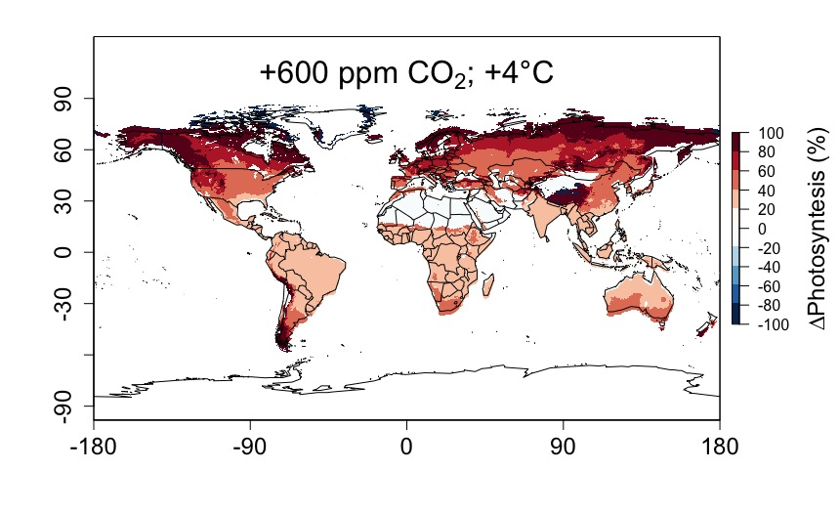
Higher CO₂ and increased temperatures increase future photosynthesis
nick.smith@ttu.edu; @nick_greg_smith
Smith and Keenan (in review)

Slide 57
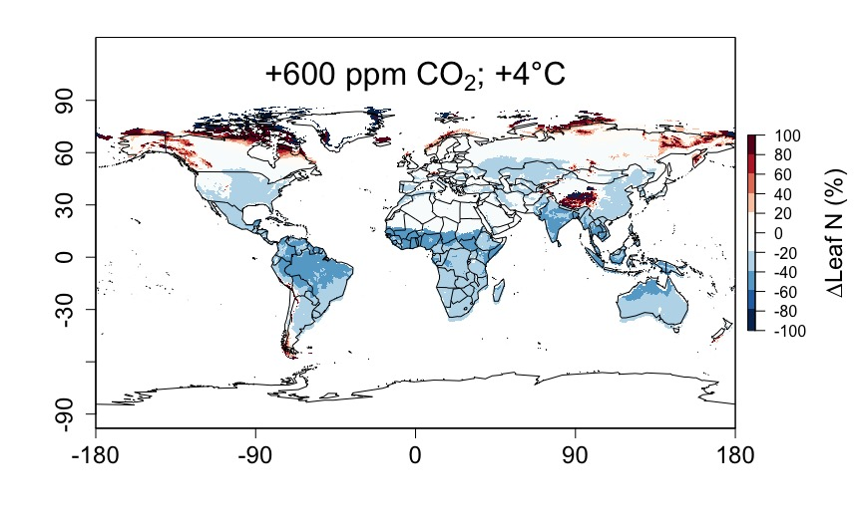
Higher CO₂ and increased temperatures increase future photosynthesis (at lower nutrient use)
nick.smith@ttu.edu; @nick_greg_smith
Smith and Keenan (in review)

Slide 58
Question 2: How will photosynthesis acclimate to future conditions? Photosynthesis will increase and per-leaf-area nutrient use will decrease
nick.smith@ttu.edu; @nick_greg_smith

Slide 59
Question 3: Does photosynthesis respond to nutrient addition?
nick.smith@ttu.edu; @nick_greg_smith
Lizz Waring
TTU

Slide 60
From the least cost hypothesis…
nick.smith@ttu.edu; @nick_greg_smith
Added nutrients will not increase photosynthesis because light limitation will kick in

Slide 61
From the least cost hypothesis…
nick.smith@ttu.edu; @nick_greg_smith
Added nutrients will not increase photosynthesis because light limitation will kick in
Optimal response would be to increase leaf area

Slide 62
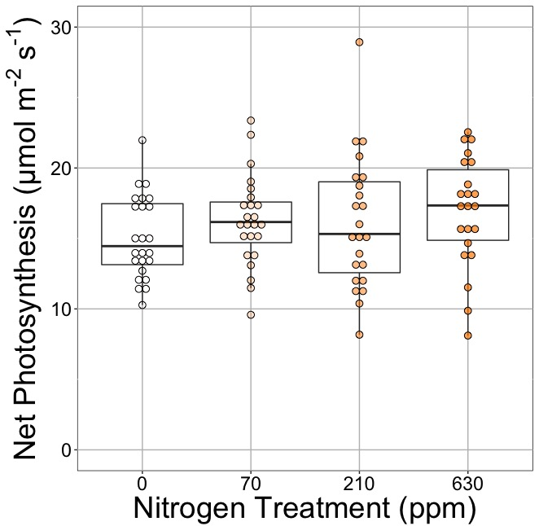
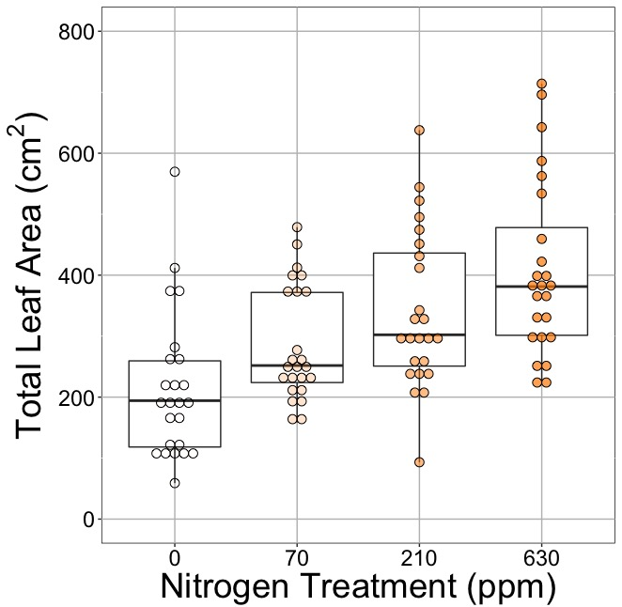
Leaf area, but not photosynthesis increases with N addition
nick.smith@ttu.edu; @nick_greg_smith
Waring and Smith (in prep)

Slide 63
Leaf area, but not photosynthesis increases with N addition
nick.smith@ttu.edu; @nick_greg_smith
Waring and Smith (in prep)

Slide 64
Leaf area, but not photosynthesis increases with N addition
nick.smith@ttu.edu; @nick_greg_smith
Waring and Smith (in prep)

Slide 65
But do greenhouse experiments translate to the field?

Slide 66
Grassland soil nutrient addition network:
Leaf area index
Per-leaf-area nitrogen (photosynthetic proxy)

Slide 67
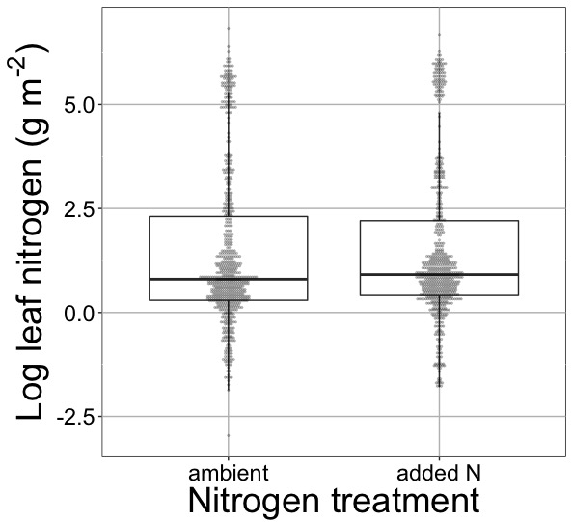
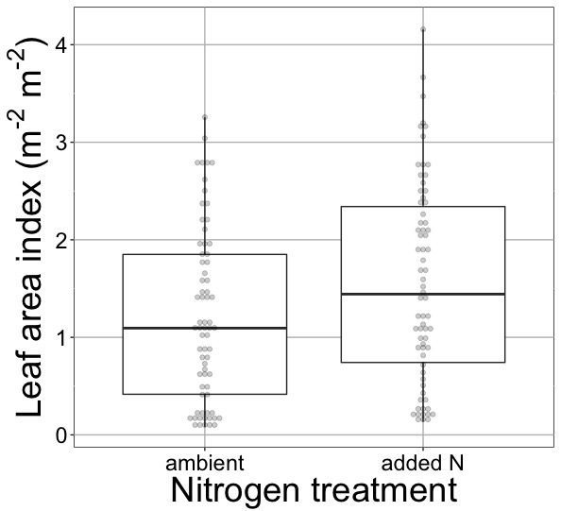
Globally, N addition increases leaf area, not leaf N
nick.smith@ttu.edu; @nick_greg_smith
No change (P = 0.42)
41% increase (P < 0.05)
Waring and Smith (in prep)

Slide 68
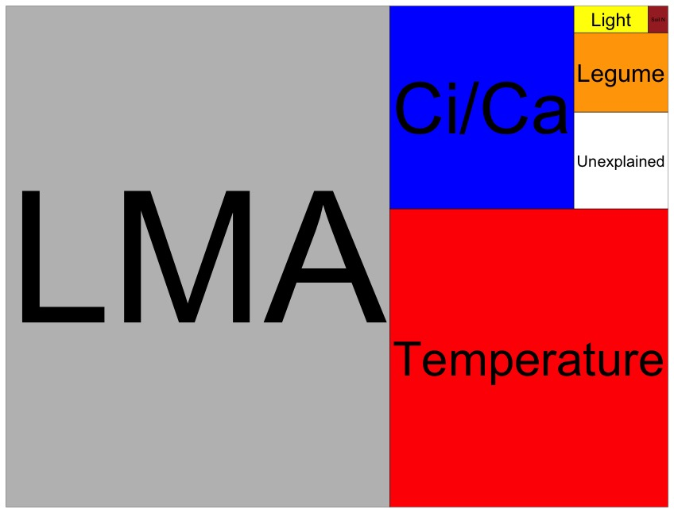
Globally, N addition has no impact on leaf N
nick.smith@ttu.edu; @nick_greg_smith
Each box is proportional to the variance in leaf N explained by each variable
Waring and Smith (in prep)

Slide 69
Question 3: Does photosynthesis respond to nitrogen addition? No, plants respond to added nitrogen by increasing leaf area, not photosynthesis
nick.smith@ttu.edu; @nick_greg_smith

Slide 70
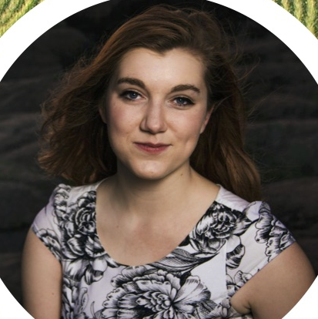
Question 4: When is C₄ photosynthesis an advantage over C₃ photosynthesis?
nick.smith@ttu.edu; @nick_greg_smith
Helen Scott
TTU

Slide 71
C₃ versus C₄ optimization
nick.smith@ttu.edu; @nick_greg_smith

Slide 72
C₄ versus C₃ optimization
nick.smith@ttu.edu; @nick_greg_smith
C₄ photosynthesis has…
No photorespiration
An additional limitation (PEP carboxylation)

Slide 73
C₄ versus C₃ optimization
nick.smith@ttu.edu; @nick_greg_smith
C₄ photosynthesis has…
No photorespiration
An additional limitation (PEP carboxylation)

Slide 74
nick.smith@ttu.edu; @nick_greg_smith
Relative advantage of C₄ physiology
Scott and Smith (in prep)

Slide 75
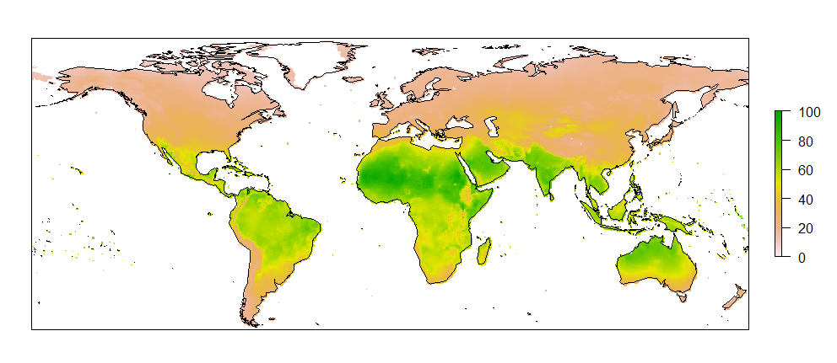
nick.smith@ttu.edu; @nick_greg_smith
Current relative advantage of C₄ (%)
Scott and Smith (in prep)

Slide 76
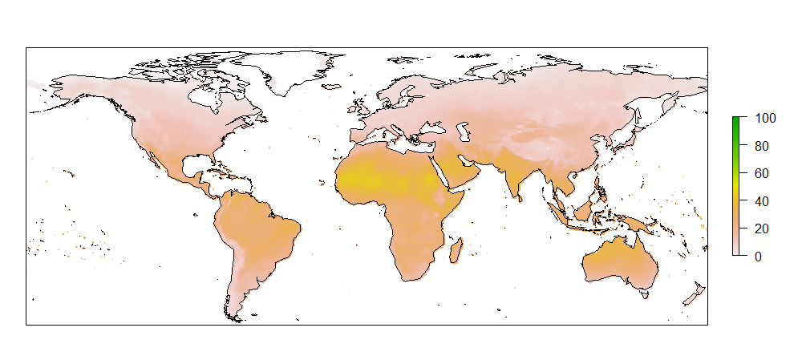
nick.smith@ttu.edu; @nick_greg_smith
Current relative advantage of C₄ (%)
Future relative advantage of C₄ (%)
Scott and Smith (in prep)

Slide 77
Question 4: When is C₄ photosynthesis an advantage over C₃ photosynthesis? C₄ is better in hot, dry, low CO₂ environments
nick.smith@ttu.edu; @nick_greg_smith

Slide 78
Conclusions
We have a theoretical model for photosynthetic acclimation
Few empirical parameters
Mechanistically based

Slide 79
Conclusions
We have a theoretical model for photosynthetic acclimation
Few empirical parameters
Mechanistically based
The theory can be useful!
Improving the reliability of climate models
Acting as a null model for understanding mechanisms

Slide 80
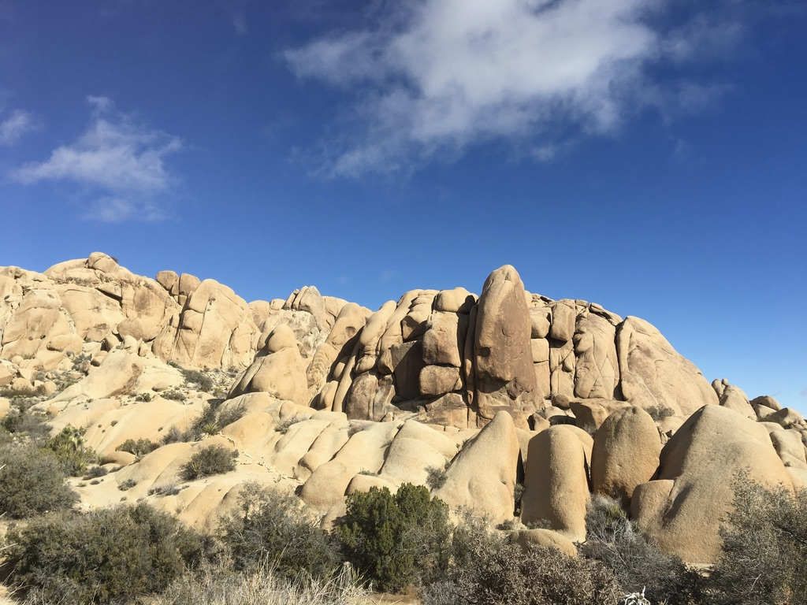
nick.smith@ttu.edu; @nick_greg_smith
Presentation available at:
github.com/SmithEcophysLab/seminar/ut_fall2019
Thanks!

Slide 81
Stomatal openness determines χ
nick.smith@ttu.edu; @nick_greg_smith
χ = internal leaf CO₂ / external leaf CO₂
χ = c_{i} / c_{a}

Slide 82
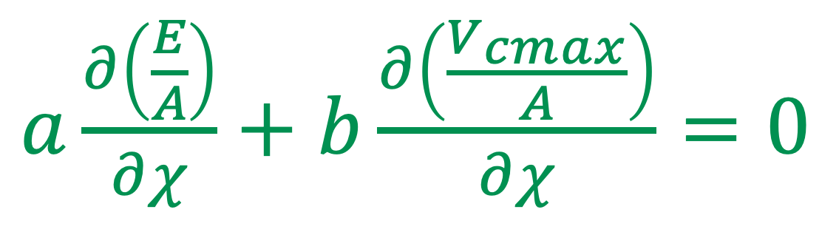
Optimal χ minimizes the costs to maintain transpiration and carboxylation
nick.smith@ttu.edu; @nick_greg_smith
$a\frac{∂\left(\frac{E}{A}\right)}{∂χ}+$ $b\frac{∂\left(\frac{V_{cmax}}{A}\right)}{∂χ}=0$
Cost factor for transpiration (E)
Cost factor for
Rubisco (V_{cmax})
Prentice et al. (2014) Ecology Letters

Slide 83
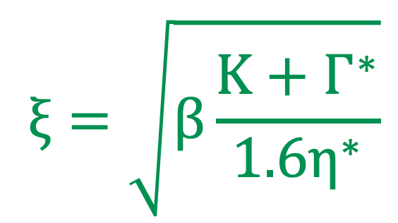
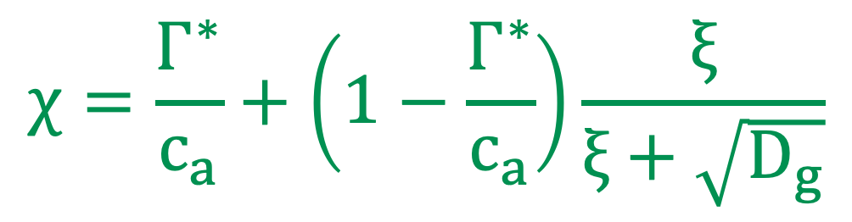
Optimal χ mathmatically
nick.smith@ttu.edu; @nick_greg_smith
$$χ=\frac{Γ^{∗}}{c_{a}}+\left(1−\frac{Γ^{∗}}{c_{a}}\right)\frac{ξ}{ξ+\sqrt{D_{g}}}$$
$$ξ=\sqrt{β\frac{K+Γ^{∗}}{1.6η^{∗}}}$$
Prentice et al. (2014) Ecology Letters

Slide 84
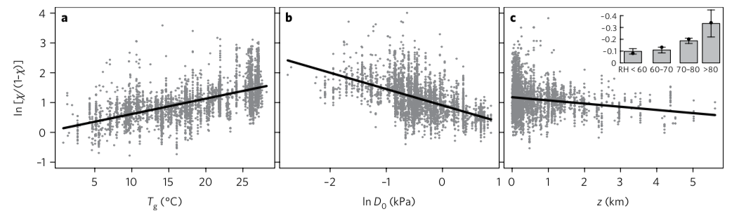
Optimal stomatal conductance
Maintain high rate of photosynthesis with stomata closed as tight as possible
Conductance
Temperature
VPD
Elevation
Wang et al. (2017)

Slide 85
Stomata open with increasing temperature
Due to increasing rates of photorespiration at high T
Conductance
Temperature
VPD
Elevation
Wang et al. (2017)

Slide 86
Stomata close with high VPD
Due to increasing rates of water loss at high VPD
Conductance
Temperature
VPD
Elevation
Wang et al. (2017)

Slide 87
Stomata close with increasing elevation
Due to lower pressure (higher VPD) at higher elevation
Conductance
Temperature
VPD
Elevation
Wang et al. (2017)

